Slide 1
Chapter 2: Network Protocols and Communications
Introduction to Networks
Notes:
Cisco Networking Academy program
Introduction to Networks
Chapter 3: Network Protocols and Communications

Slide 2
Chapter 2
2.1 Rules of Communication
2.2 Network Protocols and Standards
2.3 Moving Data in the Network
2.4 Summary
Notes:
Chapter 3 Sections

Slide 3
2.1: Rules of communications
Elements of Communications
Communication begins with a message, or information, that must be sent from one individual or device to another using many different communication methods.
These methods have 3 elements in common:
message source, or sender
destination, or receiver
a channel

Slide 4
Communication Elements include:
message source, or sender
Message sources are people, or electronic devices, that need to send a message to other individuals or devices.
destination, or receiver
The destination receives the message and interprets it.
a channel
A channel consists of media that provides the pathway over which the message can travel from source to destination.

Slide 5
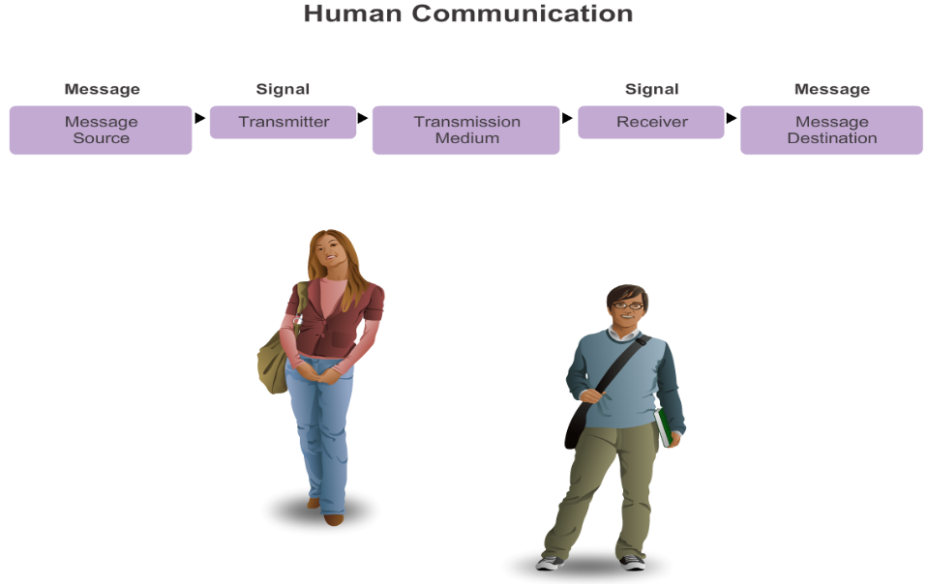
The Rules What is Communication?
Notes:
Section 3.1.1.1 Establishing the Rules
An identified sender and receiver
Agreed upon method of communicating (face-to-face, telephone, letter, photograph)
Common language and grammar
Speed and timing of delivery
Confirmation or acknowledgement requirements

Slide 6
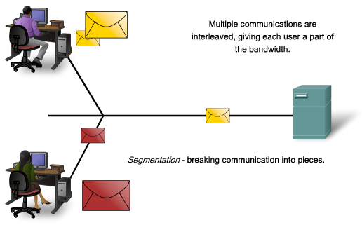
Communicating the Message
Segmentation
divide the data into smaller, more manageable pieces called segments
many different conversations can be interleaved on the network, giving each user a part of the bandwidth – multiplexing
increases the reliability of network communications

Slide 7
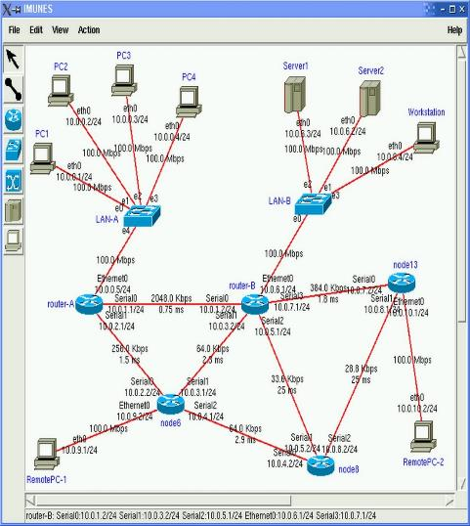
Communicating The Messages
Data is divided into smaller parts during transmission –
Segmentation
The benefits of doing so:
Increased efficiency of network communications by sending the message through different routes if necessary.

Slide 8
Communicating The Messages
Multiplexing
Multiplexing -- The process used to interleave the pieces of separate conversations together to share the medium on the network.

Slide 9
2.2: Network Protocols and Standards
(1) Network Protocols
All communication, whether face-to-face or over a network, is governed by predetermined rules called protocols.
A protocol is a formal description of a set of rules and conventions that govern a particular aspect of how devices on a network communicate.
A group of inter-related protocols that are necessary to perform a communication function is called a protocol suite. These protocols are implemented in software and hardware that is loaded on each host and network device.

Slide 10







Network Protocols and Standards Standards Organizations
Notes:
Section 3.1.3

Slide 11
Standards Organizations Open Standards
The Internet Society (ISOC)
The Internet Architecture Board (IAB)
The Internet Engineering Task Force (IETF)
Institute of Electrical and Electronics Engineers (IEEE)
The International Organization for Standards (ISO)
Notes:
Section 3.2.3.1

Slide 12
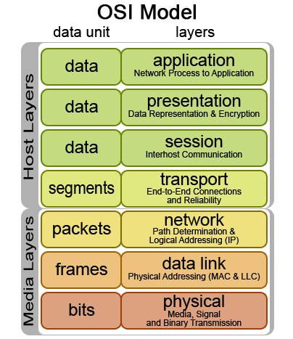

Standards Organizations ISO
Notes:
Section 3.2.3.4

Slide 13
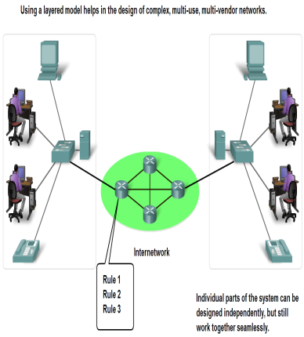
The Benefits of a Layered Model
Assists in protocol design, because protocols that operate at a specific layer have defined information that they act upon and a defined interface to the layers above and below.
Fosters competition because products from different vendors can work together.
Prevents technology or capability changes in one layer from affecting other layers above and below.
Provides a common language to describe networking functions and capabilities.

Slide 14
Protocol and Reference Models
2 types of networking models:
A protocol model provides a model that closely matches the structure of a particular protocol suite. The hierarchical set of related protocols in a suite typically represents all the functionality required to interface the human network with the data network. Ex: TCP/IP model
A reference model provides a common reference for maintaining consistency within all types of network protocols and services. A reference model is not intended to be an implementation specification or to provide a sufficient level of detail to define precisely the services of the network architecture. The primary purpose of a reference model is to aid in clearer understanding of the functions and process involved
Ex: OSI model

Slide 15
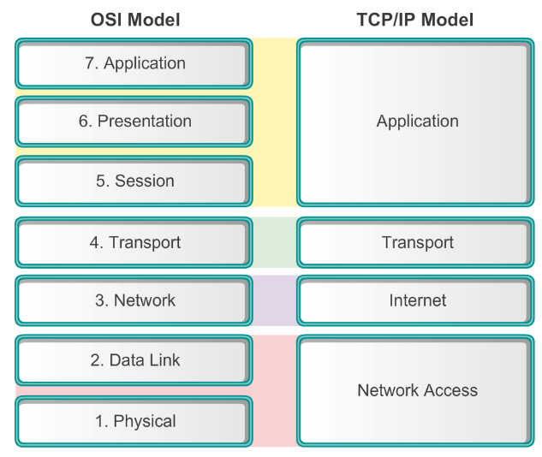
Reference Models Comparing the OSI and TCP/IP Models
Reference Model
Protocol Model
Notes:
Section 3.2.4.4

Slide 16
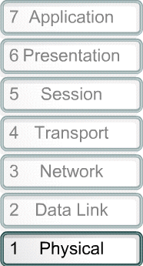
OSI Reference Model
Please Do Not Take Sausage Pizzas Away
Pew! Dead Ninja Turtle Smell Pretty Awful
All People Seem To Need Data Processing

Slide 17
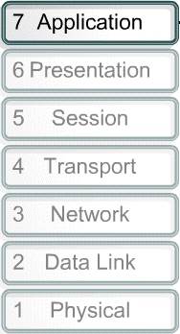
OSI Reference Model - Layer 7
The application layer contains protocols used for process-to-process communications.
Layer 7 applications: e-mail, FTP, Telnet, HTTP, etc.

Slide 18
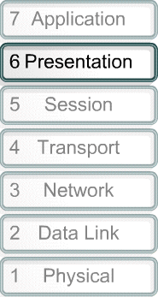
OSI Reference Model - Layer 6
To ensure information from the sender’s application layer can be read by the receiver’s application layer.
Translates multiple data formats into a common format.
Responsible for encryption and decryption.
Layer 6 common standards:
Graphic: TIFF, JPEG, PICT
Sound and movie: MIDI, MPEG

Slide 19
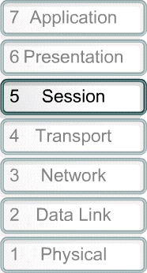
OSI Reference Model - Layer 5
Establishes, manages and terminates sessions between 2 communicating hosts
Provides service to the presentation layer by synchronizing dialog between 2 hosts’ presentation layers and manages their data exchange

Slide 20
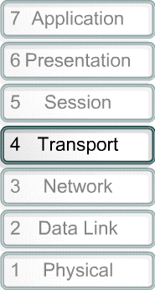
OSI Reference Model - Layer 4
The transport layer defines services to segment, transfer, and reassemble the data for individual communications between the end devices.
Layer 4 protocols: Transmission Control Protocol (TCP), User Datagram Protocol (UDP), Sequenced Packet Exchange (SPX)

Slide 21
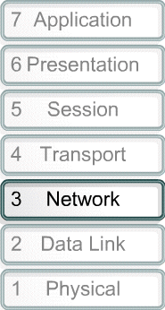
Responsible for delivery of individual packets from source to destination (host-to-host delivery possibly across multiple networks)
Concerned with logical addressing (IP address), routing, packetizing, fragmenting
Provides best path determination or “Best Effort” delivery of packet between networks
Layer 3 protocols: IP, IPX (Internetwork Packet Exchange)
Layer 3 device: Layer 3 Switches, Routers.

Slide 22
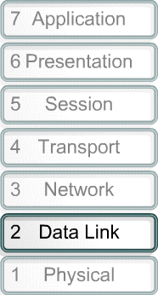
Provides transit of data across a physical link by defining the rules about how the physical link is used. (host to host delivery in the same network).
Concerned with:
Physical addressing (MAC or hardware address), Network topology, Network access and Error notification
Layer 2 protocols: Ethernet, Token Ring, PPP, Frame Relay
Layer 2 devices: bridges, switches, NICs

Slide 23
Defines the electrical, mechanical, procedural, and functional specifications for activating, maintaining and deactivating the physical link between end systems
Concerned with a raw bits transmission.
Attributes:
Voltage levels, timing of voltage changes, physical data rates, maximum transmission distances, physical connectors.
Layer 1 devices: repeaters, hubs

Slide 24
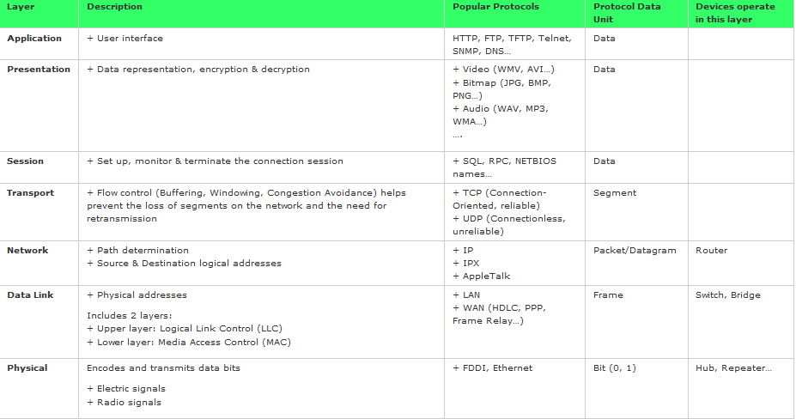
Datagram

Slide 25
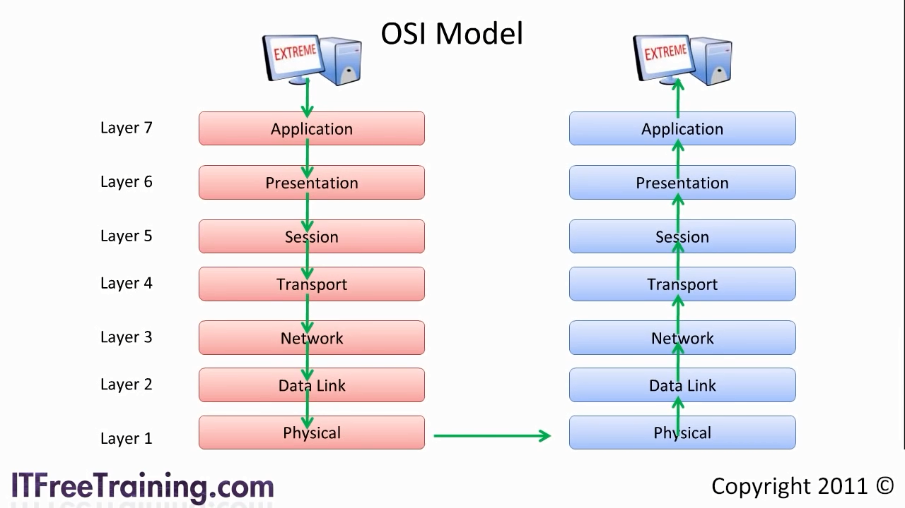
The OSI Model – Video
Notes:
Chap2-The OSI Model

Slide 26
2.3: Moving Data in the Network

Slide 27
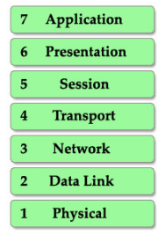
A) How a message send?

Slide 28
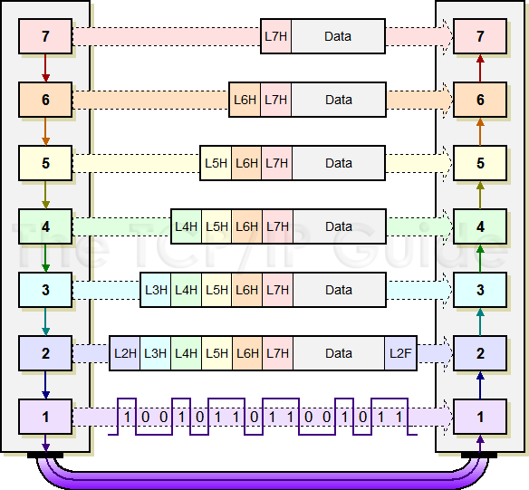
(B) Encapsulation vs Decapsulation

Slide 29
Concept of …
Encapsulation – the process by which a computer adds networking headers and trailers to data from an application for the eventual transmission of the data onto a transmission medium - Cisco
De-encapsulation – reverse of the encapsulation process
Real life example – sending letter (sender, pos office/postman, receiver)

Slide 30

Things to do….
Draw a diagram to show the
encapsulation and decapsulation process.
Games: Queue on the board
Notes:
Competition between 2 groups. Draw a diagram to show the
encapsulation and decapsulation process.
Games: pass one by one –each represent each layer
Winner: KFC voucher **

Slide 31

(B) Encapsulation vs Decapsulation

Slide 32
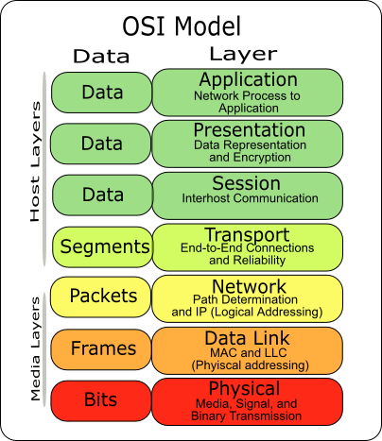
C. Data Packet Data Unit (PDU)

Slide 33
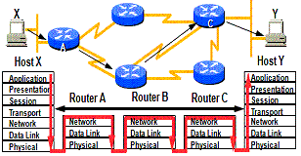
D. Routing

Slide 34
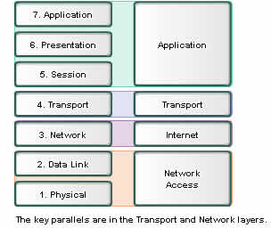
TCP/IP Vs OSI
Both have application layers, though they include very different services
Both have comparable transport & network (Internet) layers
TCP/IP combines the presentation and session layer issues into its application layer
TCP/IP combines the OSI data link and physical layers into one layer
TCP/IP appears simpler because it has fewer layers

Slide 35
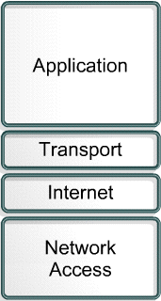
TCP/IP Networking Model
Defines the set of networking standards and protocols used to build most networks today.
Developed by the U.S. Department of Defense (DoD)
Is the historical and technical open standard used for communication on the Internet
4 layers

Slide 36
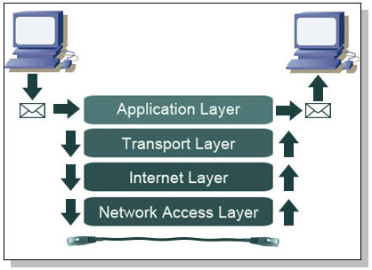
Reference Models The TCP/IP Reference Model
Notes:
Section 3.2.4.3

Slide 37
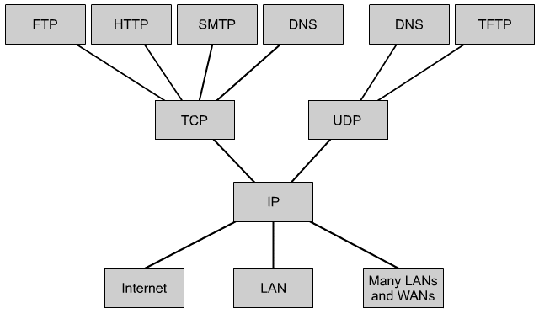
TCP/IP Protocols
Application
Transport
Internet
Network Access

Slide 38
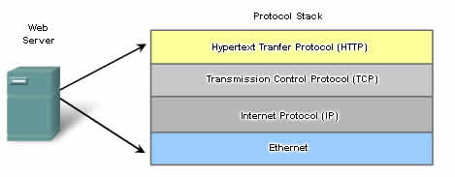
The Interaction of Protocols
Will learn more in TCP/IP model
Application protocol –HTTP defines the content and formatting of the requests and responses exchanged between the client and server
Transport Protocol –TCP divides the HTTP messages into smaller segments. It is also responsible for controlling the size and rate of message exchange.
Internetwork Protocol - IP encapsulating segments into packets, assigning the appropriate addresses, and selecting the best path to the destination host.
Network Access Protocol – Protocols for data link management and the physical transmission of data on the media.

Slide 39
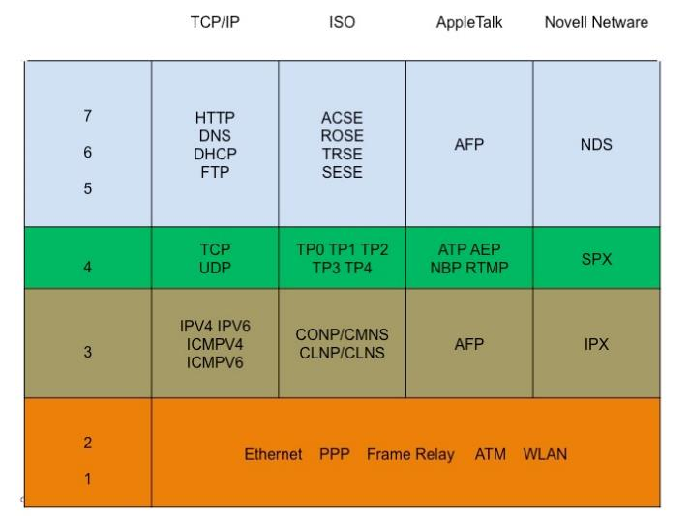
Protocol Suites Protocol Suites and Industry Standards
Notes:
Section 3.2.2.1

Slide 40
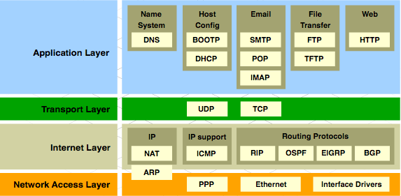
Protocol Suites TCP/IP Protocol Suite and Communication
Notes:
Section 3.2.2.3

Slide 41
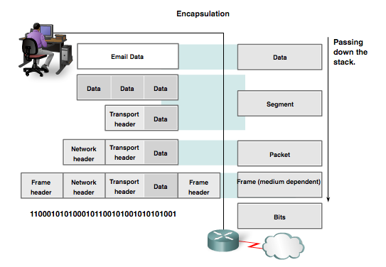
Data Encapsulation Protocol Data Units (PDUs)
Data
Segment
Packet
Frame
Bits
Notes:
Section 3.3.1.2

Slide 42
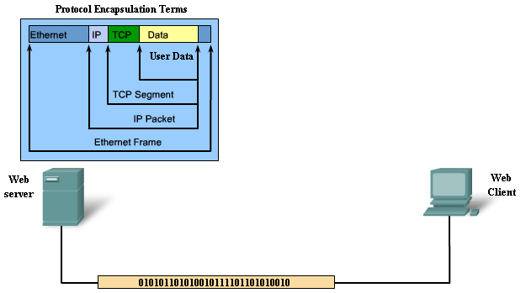
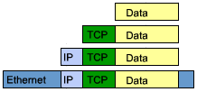

Sending Process (cont’d)
CCNAR&S
3.3.1.3

Slide 43
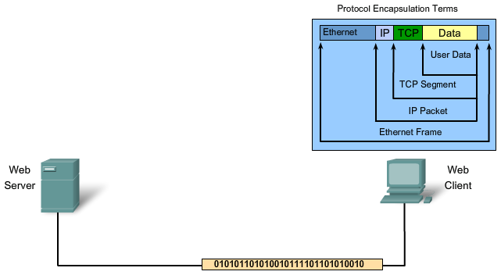
Receiving Process
CCNAR&S
3.3.1.4
2.4.6.2
Notes:
This process is reversed at the receiving host. The data is decapsulated as it moves up the stack toward the end user application.

Slide 44
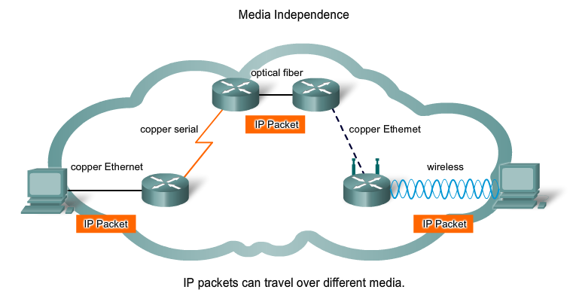

Slide 45


